Slide 1
Graceful Labeling of Trees and Integer Programming
AJH - 90
Saylor Barnette
Steven B. Horton
William R. Pulleyblank
Department of Mathematical Sciences

Slide 2

Steven B. Horton
Department Head, Mathematical Sciences
USMA West Point

Slide 3
Labeling
Labeling (Alex Rosa 1967) :
G = (V, E) is a connected undirected graph with m edges.
A node labeling l_{v} is an assignment of a distinct integer 0, 1, 2, …, m to each node v of G.
Compute edge labels d_{uv} = |l_{v} – l_{u}| for each edge uv of G.
0
12
12
4
11
3
6
1
3
6
5
4
14
7
1
11
1
10
4
9
14
5

Slide 4
Graceful Labeling
A labeling is graceful if every edge gets a distinct label.
6
2
1
7
0
8
6
7
8
2
4
5
4
5
3
3
1
Conjecture: (Ringel-Kotzig)
Every tree has a graceful labeling.

Slide 5
U Waterloo 1970
C&O 768: Crispin St.-J. A. Nash-Williams
Homework Problem 1: Find the largest integer k such that for
any tree T having 1000 vertices there is a labeling of the vertices with distinct labels l_{v} from {0, 1, 2, …, 999} so that there are at least k edges uv having different values | l_{v –} l_{u}|.
General approach – show that a tree has high degree vertices or has a large caterpillar (path plus pendant edges).

Slide 6
Paths and caterpillars
0
10
2
7
6
10
8
5
1
9
7
6
4
3
2
1
9
8
3
4
5
Paths and caterpillars have graceful labelings in which all nodes on one side of the bipartition get low labels and the nodes
on the other side get high labels

Slide 7
Gallian Survey
Joseph A. Gallian, A Dynamic Survey of Graph Labeling, The Electronic Journal of Combinatorics 16 (2013), 1-308.
Department of Mathematics and Statistics
University of Minnesota Duluth
Sixteenth edition, December 20, 2013
jgallian@d.umn.edu
… regularly updated -

Slide 8
Sample
From J. A. Gallian, A Dynamic Survey of Graph Labeling
Graph | Graceful
trees | G - if 35 vertices or less[484]
 | G - if symmetrical [266]
 | G - if at most 4 end-vertices [671]
 | G? - Ringel-Kotzig
 | G - caterpillars [1209]
 | G - firecrackers [371]
 | G - bananas [1312]
 | G? - lobsters [262]

Slide 9
Lobsters
Start with a caterpillar.
Add arbitrarily numbers of pendant edges to each vertex.
Conjecture (Jean-Claude Bermond [1979] ): Every lobster has a graceful labeling. Still unresolved

Slide 10
Spiders
6
7
4
8
3
4
9
10
1
5
8
12
0
1
3
12
10
13
13
2
2
11
11
7
9
6
5
Bahls, Lake, and Wertheim show spiders have graceful labelings, if all “legs” have lengths n or n+1 for some n

Slide 11
α- and bipartite labeling
Rosa - An α-labeling is a graceful node-labeling l such that for each edge uv, either l_{u} ≤ k < l_{v} or l_{v} ≤ k < l_{u} for some integer k.
An α-labeling is one in which each node on one side of the bipartition gets a high label and each node on the other side gets a low label.
Let U and V be the sets of nodes on the two sides of a tree T. A bipartite labeling is one for which, for each edge uv, with u ∈ U and v ∈ V, l_{u} > l_{v .}

Slide 12
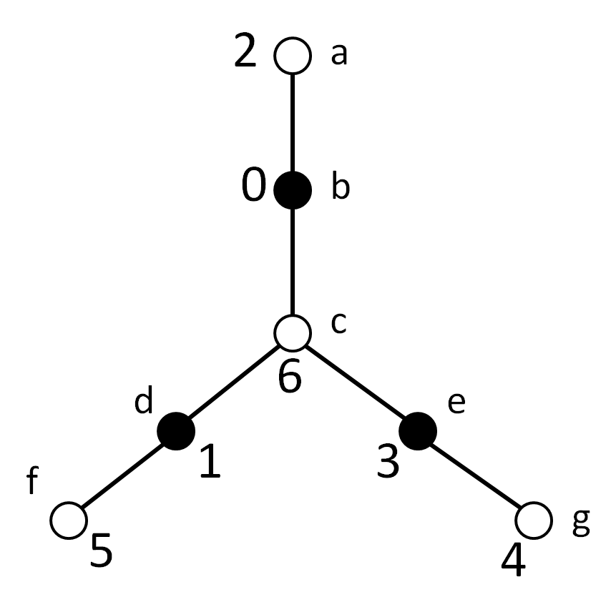
Tree with bipartite but no α-labeling
Every α-labeling is a bipartite labeling but the
converse is not true.
Tree with bipartite but no α-labeling

Slide 13
Mathematical Programming
Formulating Graceful Labeling of Trees as a mixed integer linear programming (MIP) problem
- Use Birkhoff’s Theorem to make x_{iv} incidence vector of an assignment of 0, 1, …, m to the nodes.
- Extract a set of node labels l_{v} from x_{iv}.
- Use Birkhoff’s Theorem to make y_{je} incidence vector of an assignment of 1, …, m to the edges.
- Extract a set of edge labels d_{e} from y_{je} .
- Link together the l_{v} and d_{e} so that l_{v} is forced to be a graceful labeling.

Slide 14
Compute l_{v} , d_{e}
1. Define a 0-1 variable x_{iv} for v ∈ V, for i ∈ {0, 1, …, m}
with the interpretation
  x_{iv} = 1 if node v is assigned the value i,
  x_{iv} = 0 if not.
  S (x_{iv} : i ∈ {0, 1, …, m} ) = 1 for all v ∈ V,
  S(x_{iv} : v ∈ V) = 1 for all i ∈ {0, 1, …, m} ,
  x_{iv} ≥ 0 for all i ∈ {0, 1, …, m}, v ∈ V.
2. Compute node labels
l_{v} = S (i x_{iv} : i ∈ {0, 1, …, m} ) for all v ∈ V.
3., 4. Compute d_{e} analogously for edges.

Slide 15
Orientations
5. We require d_{uv} = |l_{v} – l_{u} | ^{(*)} for all edges uv.
The absolute value causes a complication. We orient the edges and replace ^{(*)} with
d_{uv} = l_{u} – l_{v} for all uv.
This is satisfied if l_{u} > l_{v} but violated if l_{u} < l_{v} .
Add a new 0-1 variable r_{uv} for each edge uv; interpretation: if r_{uv} = 0, we keep the orientation. If r_{uv} = 1, we reverse it.
For all edges uv, d_{uv} ≥ l_{u} – l_{v}
d_{uv} ≤ l_{u} – l_{v} +2m r_{uv}
d_{uv} ≥ l_{v} – l_{u}
d_{uv} ≤ l_{v} – l_{u}+2m(1 - r_{uv} ).
-
+
u
v

Slide 16
What happened?
We ran this formulation, minimizing S r_{uv} which equals the number of edges for which the initial orientation was reversed.
Bipartite Orientation: Trees are bipartite; 2-color the nodes black and white then orient every arc from black to white.
When we ran with a bipartite orientation then no edges had to have their orders reversed for any tree we tried!
6
2
1
7
0
8
6
7
8
2
4
5
4
5
3
3
1

Slide 17
Sample runs
Number of nodes | Running time (h:m:sec:csec) | Comment
55 | 00:08:10:38 | Lobster – bipartite labeling
105 | 06:13:23:06 | Lobster – bipartite labeling
23 | 00:00:01:02 | Lobster – bipartite labeling
81 | 36 hours plus | Lobster – no labeling
53 | 00:04:34.71 | Lobster – bipartite labeling
52 | 00:00:18:97 | Lobster – bipartite labeling
30 | 00:00:02:19 | Lobster – bipartite labeling
40 | 00:00:11:48 | Lobster – bipartite labeling
91 | 01:41:49.86 | Lobster – bipartite labeling
69 | 01:13:37:35 | Lobster – bipartite labeling
81 | 02:41:22:38 | Lobster – bipartite labeling
86 | 01:24:42:33 | Lobster – bipartite labeling

Slide 18
Bipartite labeling of a spider
6
3
2
3
1
12
10
5
1
7
12
13
10
2
13
0
7
9
9
8
8
11
11
4
4
6
5

Slide 19
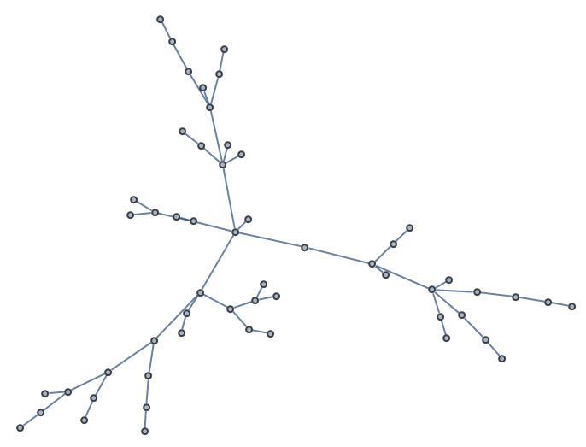
55 node random tree
55 node random tree
Graceful labeling constructed in 8 minutes, 44.85 seconds on a Dell 4-core laptop using CPLEX

Slide 20
Strong Conjecture
Bipartite Labeling: Labeling consistent with a bipartite orientation.
Conjecture: Every tree has a bipartite graceful labeling
- If false and there exist trees without bipartite graceful labelings, characterize (or at least find a class of) such trees.
A fractional version of the conjecture is true. For every tree, there exists a convex combination l of bipartite labelings and a convex combination d of edge labelings such that l and d satisfy the linking constraints.

Slide 21
Complexity question:
What is the complexity of determining whether a tree has an α-labeling? Does it help knowing how the high and low labels split up?
The MIP formulation can solve this – minimize or maximize the sum of the labels on one side of bipartition of tree.
Some spiders do, some spiders don’t.

Slide 22
Polyhedral Question
Let P = { x: Ax ≤ b } be an integral polyhedron.
Let Q = {y: Cy ≤ d } be an integral polyhedron.
Let R = {(x,y) = 0 } define a linear space on x, y.
When does there exist integral x ∈ P, integral
y ∈ Q such that (x,y) ∈ R?
Our R is really simple – the incidence structure of a tree. Can that help?

Slide 23
Optimal Linear Arrangements
A linear arrangement of a graph G = (V, E) is a node labeling
( l_{v} : v ∈ V) of G; let d_{uv} = (|l_{v} – l_{u}|: uv ∈ E ) be the vector of induced edge labels.
An Optimal Linear Arrangement of G is a linear arrangement for which S d_{uv} is minimized.
Graceful Labeling
Linear Arrangement of value 12
6
2
0
7
2
1
7
0
8
2
3
6
1
3
1
1
4
2
5
3
1
4
1
8
1
5

Slide 24
OLA on trees
0
1
2
3
4
5
6
7
8
Goldberg Klipker(1976) and Shiloach (1979) gave a polynomial algorithm for solving OLA for trees.
References
M. K. Goldberg and I. A. Klipker. Minimal placing of trees on a line. Technical report. Physico-Technical Institute of Low Temperatures. Academy of Sciences of Ukranian SSR, USSR (in Russian) (1976).
Shiloach, Y., A minimum linear arrangement algorithm for undirected trees, SIAM J. Comput., Vol. 8, 15-32 (1979).
Chung, F. R. K., On Optimal Linear Arrangements of Trees, Comp. & Maths. with Appls. Vol. 10, No. 1, 43-60 (1984).
Horton, Steven B., The Optimal Linear Arrangement Problem: Algorithms and Approximation, PhD Thesis, GA Tech (1997).

Slide 25
Series-Parallel Graphs
A 2-terminal recursive graph class.
  Recognizable in linear time.
  Contain no subgraph homeomorphic to K₄ (no topological K₄ minor).
  Can be built from K₂ (a single edge) using (only) two operations: series and parallel composition

Slide 26
Series Operation
G₂
1
3
G₁
7
4
5
8
8
2
6

Slide 27
Series Operation
G₂
1
3
G₁
7
4
5
8
8
2
6

Slide 28
Series Operation
G₂
1
3
G₁
7
4
5
8
8
2
6

Slide 29
Series Operation
G₂
1
3
G₁
7
4
5
8
8
2
6
Vertex 8 loses its
terminal status

Slide 30
Series Operation
1
3
G
7
4
5
8
2
6
Vertex 8 loses its
terminal status

Slide 31
Parallel Operation
9
7
G₁
4
7
3
1
G₂
4
5
8
2
6

Slide 32
Parallel Operation
9
7
G₁
3
7
4
1
G₂
4
5
8
8
2
6

Slide 33
Parallel Operation
9
7
G₁
3
7
1
G₂
4
4
5
8
8
2
6

Slide 34
Parallel Operation
9
7
G₁
3
7
1
G₂
4
4
5
8
8
2
6

Slide 35
Parallel Operation
9
7
G₁
3
7
1
G₂
4
4
5
8
8
2
6

Slide 36
Parallel Operation
9
7
G₁
3
7
G₂
1
4
4
5
8
8
2
6

Slide 37
Parallel Operation
9
7
3
7
G
1
4
4
5
8
8
2
6

Slide 38
OLA Questions
Conjecture: The OLA problem can be solved in polynomial time for series-parallel graphs.
What can be said about the weighted problem for trees?
9
7
3
7
G
1
4
4
5
8
8
2
6

Slide 39


Thanks
And congratulations, Alan!

